Slide 1
Atmospheric Chemistry
Option 1B

Slide 2
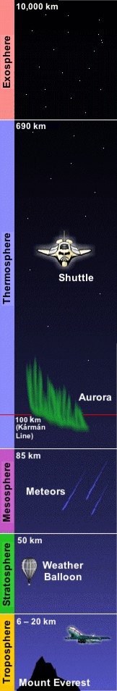
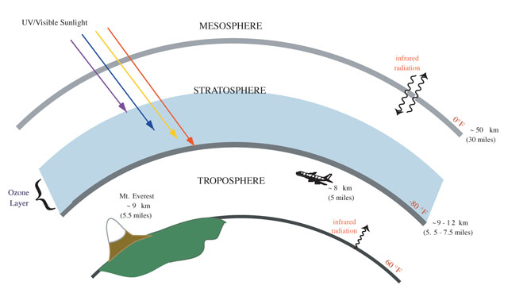
The Atmosphere
The atmosphere is a layer of gases that extends about 100km above the surface of the earth.

Slide 3
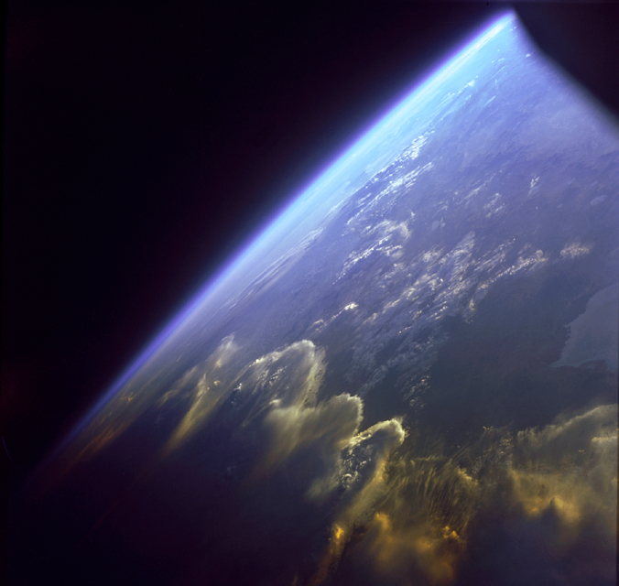
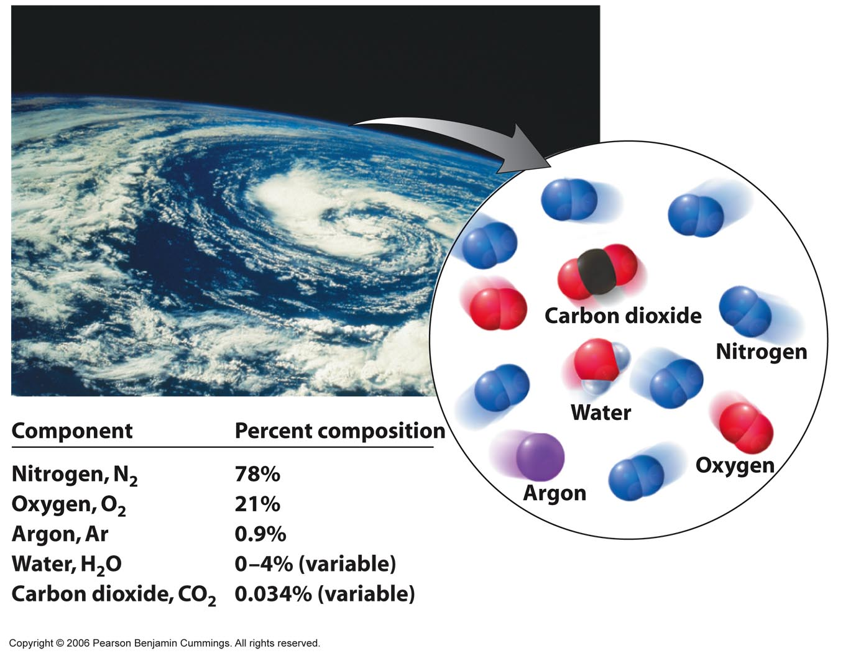
The Earth’s Atmosphere
From Space
Component Percent composition
Nitrogen, N₂ 78%
Oxygen, O₂ 21%
Argon, Ar 0.9%
Water, H₂O 0 – 4% (variable)
Carbon dioxide, CO₂ 0.034% (variable)
Copyright © 2007 Pearson Benjamin Cummings. All rights reserved.

Slide 4
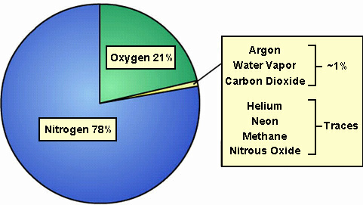
Air
Air is a mixture of gases.
Composition of dry unpolluted air

Slide 5
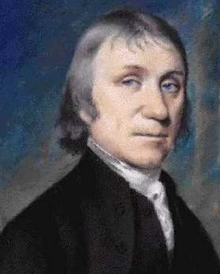

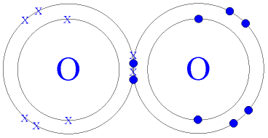
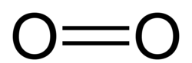
1B.1 Oxygen
Oxygen is the most reactive gas in the air.
It was discovered by Joseph Priestly in 1778.
It supports combustion.
It reacts with most elements to form oxides.
It is a diatomic gaseous element and non-polar molecule.

Slide 6

Laboratory preparation of O2
H₂O₂ ------ H₂O + ½ O₂

Slide 7
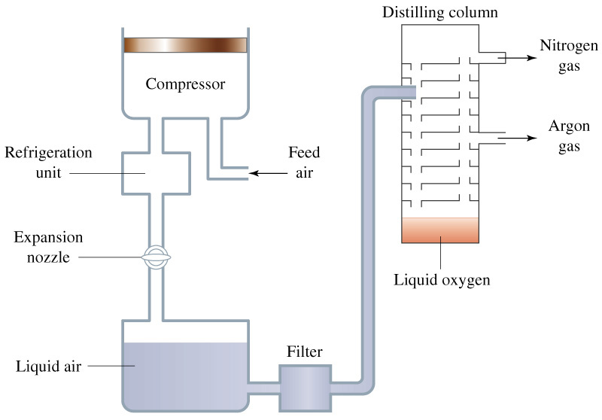
Manufacture of oxygen
Liquefaction & Fractional Distillation of air

Slide 8
Manufacture of oxygen - liquefaction & fractional distillation of air
Air
Filter removes dust
CO₂ removed by NaOH
H₂O removed by silica in drying tower
N₂, O₂ and noble gases are compressed and cooled
Gases expand
Liquid air
Fractionating column
Oxygen
Argon
Nitrogen

Slide 9
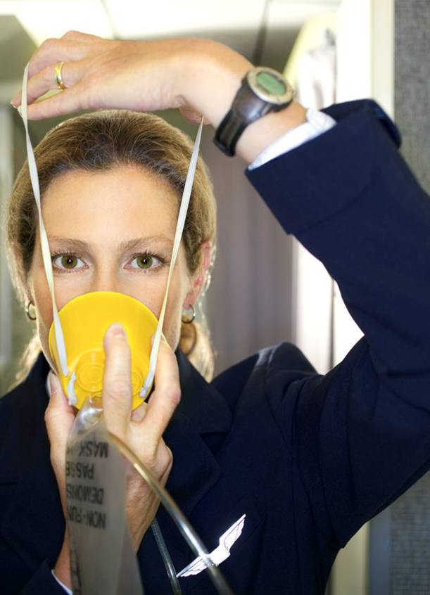
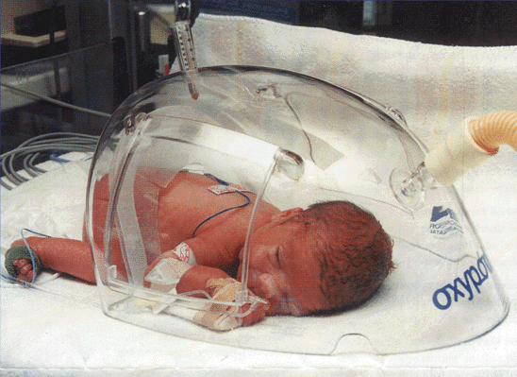
Uses of oxygen
Oxygen is used to help in breathing e.g. premature babies, on aeroplanes, patients recovering from heart attacks or with lung ailments.

Slide 10
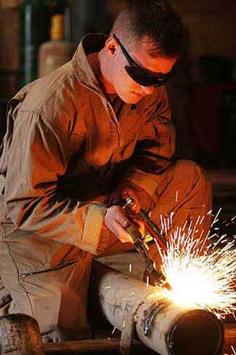
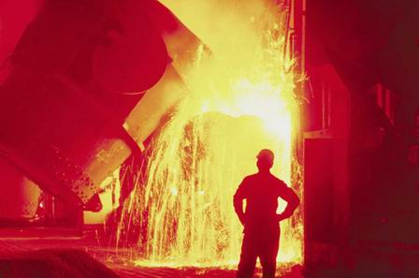
Uses of oxygen
Oxygen is with ethyne form oxyacetylene torches used for cutting and welding metals.
Oxygen is also used in steel making.

Slide 11
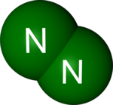
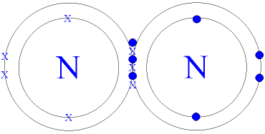
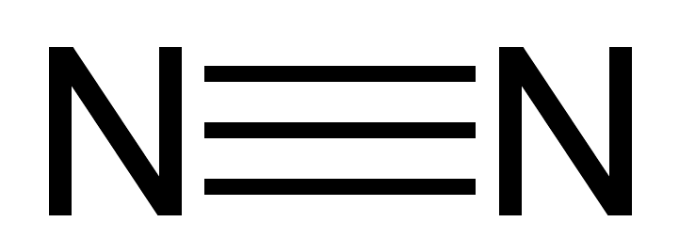
1B.2 Nitrogen
Nitrogen is a very stable inert diatomic gaseous element.
It is the most abundant gas in the air (78%)
It has a triple pure covalent bond and is a non-polar molecule.

Slide 12
Nitrogen Fixation
Nitrogen is a vital element – used to make proteins.
Nitrogen Fixation: is the conversion of atmospheric nitrogen into compounds that can be used by plants.
  Natural Fixation
  Artificial Fixation (Haber-Bosch Process)

Slide 13
Natural Fixation
During thunderstorms the lightning flashes provides enough energy for nitrogen and oxygen to react forming nitrogen monoxide which spontaneously reacts with air to form nitrogen dioxide which dissolves in rainwater to form nitrous and nitric acid.
N2 + O2 = 2NO
2NO + O2 = 2NO2
2NO2 + H2O = HNO2 + HNO3

Slide 14
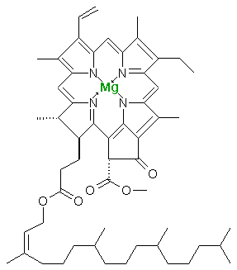
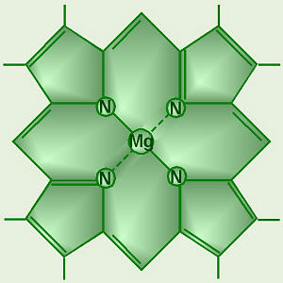
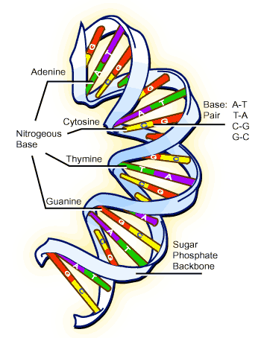
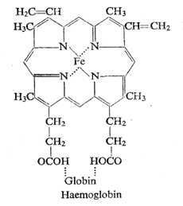
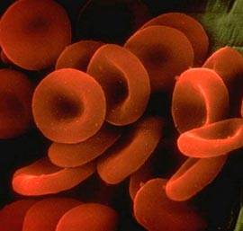
These acids (nitrous & nitric acid) fall to earth in rainwater and form nitrates in the soil, which are absorbed by plants and used to make proteins. Animals get their protein by either eating plants or eating other animals.

Slide 15
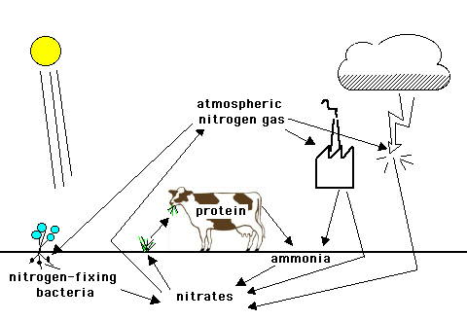
Nitrogen Cycle

Slide 16
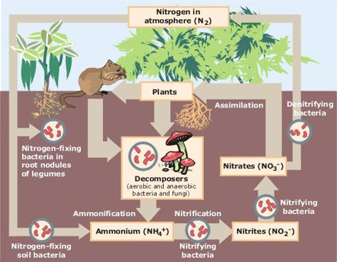
Nitrogen Cycle

Slide 17
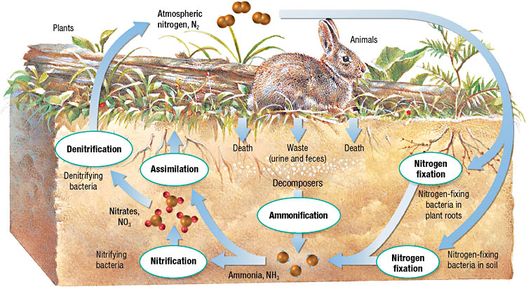
Nitrogen Fixing Bacteria: some are free living in the soil, while others are found in the roots of legumes in nodules. They convert the atmospheric nitrogen into a form that the plant can use – nitrates.

Slide 18
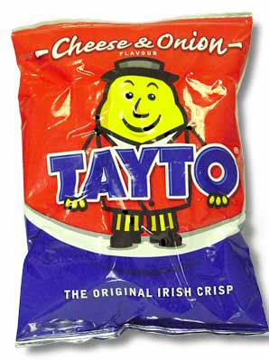
Uses of Nitrogen Gas
N2 gas is used in food packaging e.g. in a bag of crisps it acts a ‘cushion’ to help prevent them getting broken and because of its inertness N2 helps keep them fresh for longer by preventing oxidation which causes fat to go rancid.

Slide 19
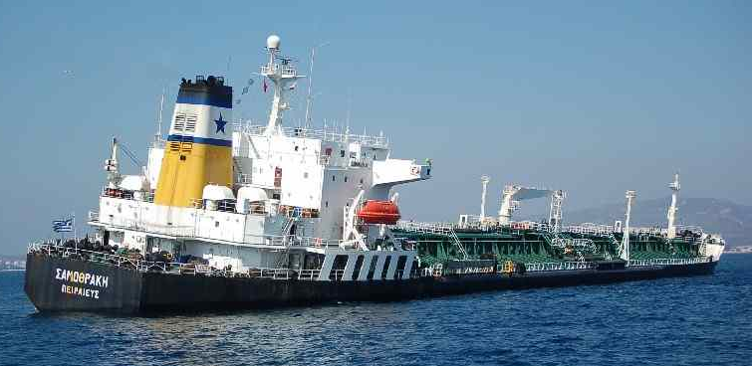
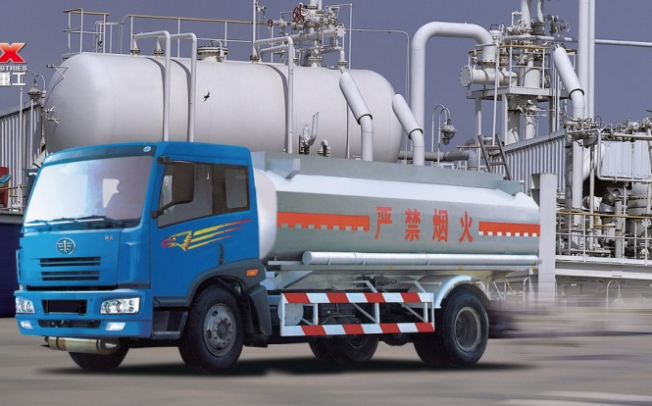
Uses of Nitrogen Gas
N2 gas is used to flush out empty oil tankers when they are idle to reduce the risk of flammability.
N2 is used in the unloading of oil from ships as it acts as a ‘blanket’ above oil and prevents vapours from igniting.
N2 is used to make ammonia (NH3) in Haber Bosch Process.

Slide 20

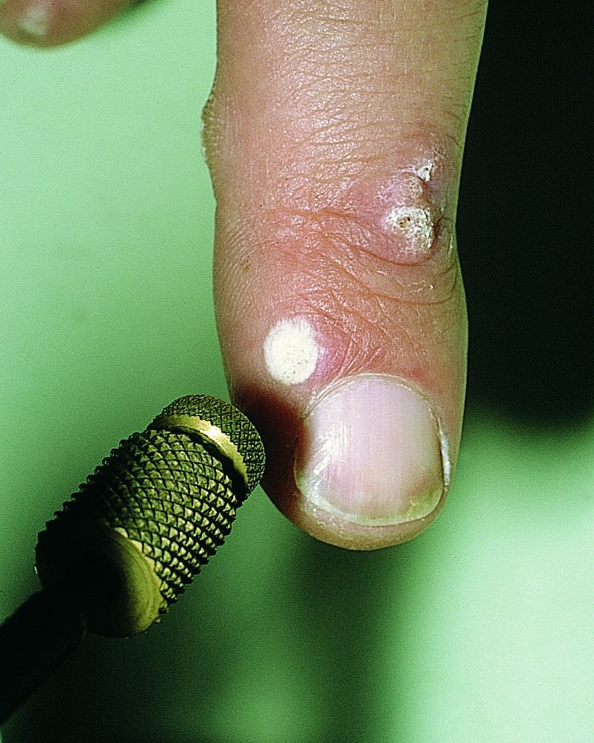
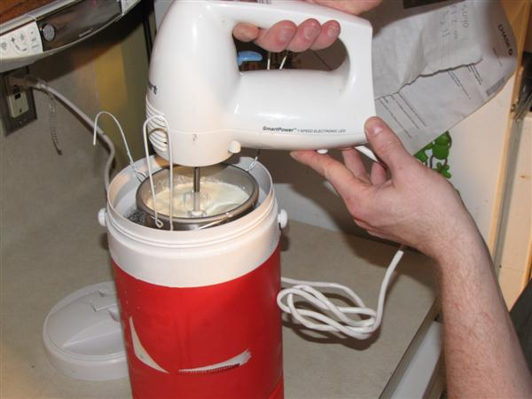
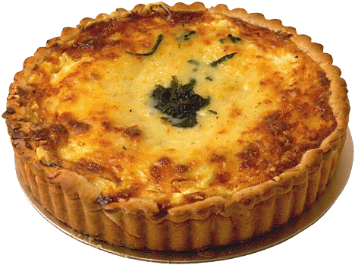
Uses of Liquid Nitrogen
Liquid nitrogen is used in medicine to remove warts and to store donor organs.
It is also used in the food industry to make ice cream and to quick freeze foods.

Slide 21
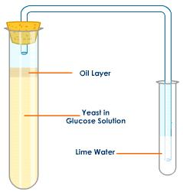
1B.3 Carbon Dioxide
Manufacture of CO2 by fermentation of yeast
In the brewing industry CO2 is a co-product of ethanol.
C₆H₁₂O₆ 2C₂H₅OH + 2CO₂

Slide 22
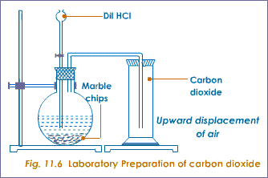
Laboratory preparation of CO2
CaCO₃ + 2HCl CaCl₂ + H₂0 + CO₂

Slide 23
Carbon Monoxide
When carbon is burned in a limited amount of oxygen incomplete combustion occurs and forms carbon monoxide. C + 1/2O2 = CO
It is a neutral oxide.
It is a colourless odourless poisonous gas ‘silent killer’.
It prevents the formation of oxyhaemoglobin.

Slide 24

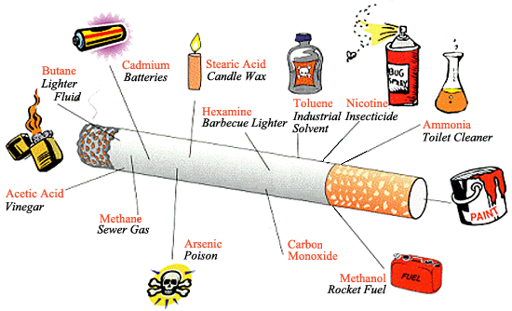

Sources of CO
Cigarette smoke.
Vehicle exhaust fumes.

Slide 25
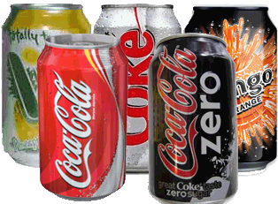
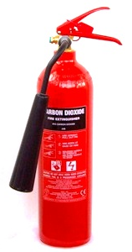
Carbon Dioxide
When carbon is burnt in excess oxygen complete combustion forms carbon dioxide.
It is an acidic gaseous oxide.
Uses of CO2:
Fizzy drinks
Fire extinguishers
Dry ice CO2(s)

Slide 26
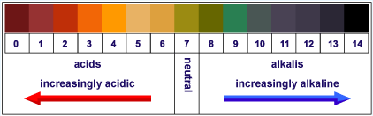
Universal Indicator
Universal indicator is a mixture of indicators that shows a wide range of colours depending on the pH of the solution.

Slide 27
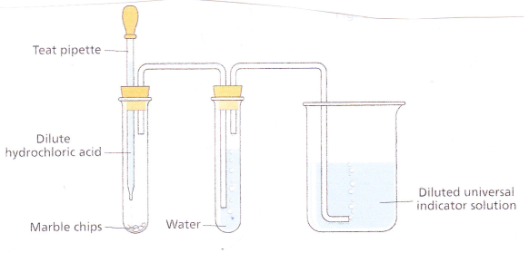
Specified Demonstration
Effect of CO2 on universal indicator

Slide 28
The effect of carbon dioxide on universal indicator solution
Method:
Place 25cm³ of universal indicator into a 100cm³ beaker and dilute with equal volume of water.
Place a few marble chips in a test tube and set up apparatus as shown.
Add dilute HCl drop-wise.
Result:
As CO₂ gas is bubbled into a sample of universal indicator, the pH is gradually lowered as the amount of CO₂ increases and a series of colour changes is seen as the pH drops. Colour changes from green to red.

Slide 29
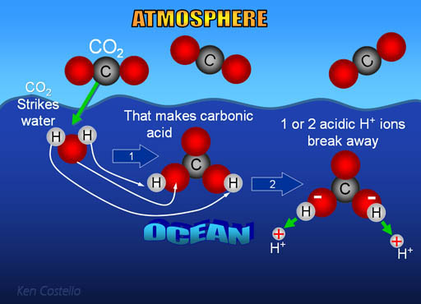
CO2 in water can be free CO2(g) or combined as C03²⁻ or HCO3⁻

Slide 30
Carbon Dioxide in Water
Carbon dioxide is fairly soluble in water.
CO₂ (g) + excess H₂O CO₂ (aq)
A small amount of dissolved CO2 reacts with water to form carbonic acid.
CO₂ (aq) + H₂O (l) H₂CO₃ (aq)
As this is a weak acid it dissociates slightly.
H₂CO₃ (aq) H⁺ + HCO₃⁻ (aq)
Under alkaline conditions a further dissociation occurs.
HCO₃⁻ (aq) H⁺ + CO₃²⁻ (aq)

Slide 31
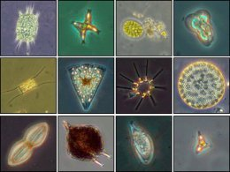
Dissolving C02 in oceans
At the surface of the oceans, air is constantly coming into contact with the water. Some of the carbon dioxide that dissolves in the water is changed into hydrogencarbonates and carbonates.
Some of it is used up in photosynthesis by phytoplankton, while some is dispersed to deeper regions by ocean currents where the low temperatures ensure that it remains dissolved.
These interaction of atmospheric carbon dioxide with the oceans is a significant factor in limiting the greenhouse effect.

Slide 32
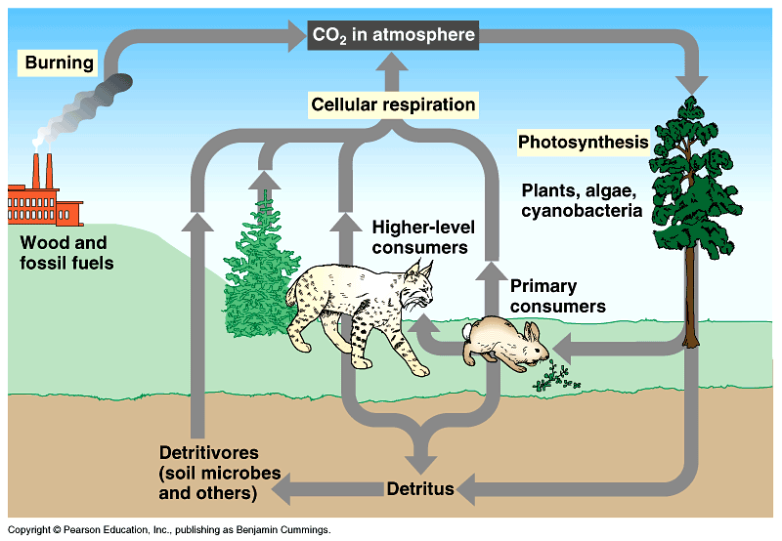
The Carbon Cycle
The carbon cycle shows how CO2 is recycled

Slide 33
The Carbon Cycle
CO2 is added to the atmosphere by:
Respiration: C6H12O6 + 6O2 6CO2 + 6H2O
Burning fossil fuels: CH4 + 2O2 CO2 + 2H2O
Roasting limestone: CaCO3 CaO + CO2

Slide 34
The Carbon Cycle
CO2 is removed from the atmosphere by:
Photosynthesis: 6CO2 + 6H2O C6H12O6 +6O2
Dissolving in water (oceans, rivers, lakes, rain etc)
CO2 + H2O H2CO3

Slide 35
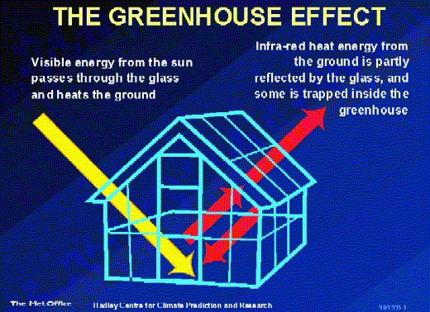
The Greenhouse Effect
Radiation from the sun falls on the Earth and warms it up. The Earth loses some of the heat as it cools down. However, the atmosphere helps to trap some of the energy being lost, i.e. the atmosphere helps to keep the earth warm. This trapping of the sun’s energy by the atmosphere is called the greenhouse effect.

Slide 36

The Greenhouse Effect
Reflected heat lost to
outer space
Light from
the sun
Reflected heat
absorbed by
atmosphere
Notes:
Radiant energy from the sun enters the Earth’s atmosphere and is reflected off the surface of Earth back to outer space. The carbon dioxide and other gases in the atmosphere trap the radiant heat from leaving. This is like a greenhouse – where the glass allows the light energy in but traps the heat from escaping. Recall, when you go to your car in the winter on a sunny day. The interior of the car is warm. On a summer day the car is too hot inside if you don’t leave a window rolled down slightly to allow the heat to escape (heat rises).

Slide 37
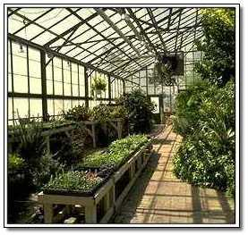
The Greenhouse Effect
This effect is a completely natural occurrence. Without the greenhouse effect a lot of heat energy would be lost from the Earth into outer space and the Earth would become covered by a thick sheet of ice and life on earth could not exist!
It is found that some gases are particularly good at absorbing the heat energy given off by the Earth as it cools down. Such gases are commonly referred as greenhouse gases.

Slide 38
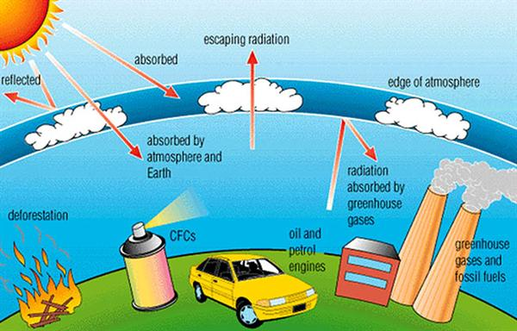
The Greenhouse Gases

Slide 39
Contribution of the main greenhouse gases to Global Warming

Slide 40
Carbon Dioxide Levels
350
Atmospheric
CO₂ (ppm)
300
250
1000
1500
2000
Year

Slide 41
Greenhouse Factor
Greenhouse Factor is a measure of the greenhouse effect caused by a gas relative to the same amount of CO₂, which is assigned a greenhouse factor of 1.
Gas | Greenhouse factor
Water vapour | 0.1
Carbon dioxide | 1
Methane | 30
Nitrous oxide | 160
CFC’s | 21,000 – 25,000

Slide 42

Global warming
So increasing concentrations of greenhouse gases may be causing the Earth to get warmer. This occurrence is called the enhanced greenhouse effect.
The extra warming that results from the enhanced greenhouse effect is called global warming.

Slide 43
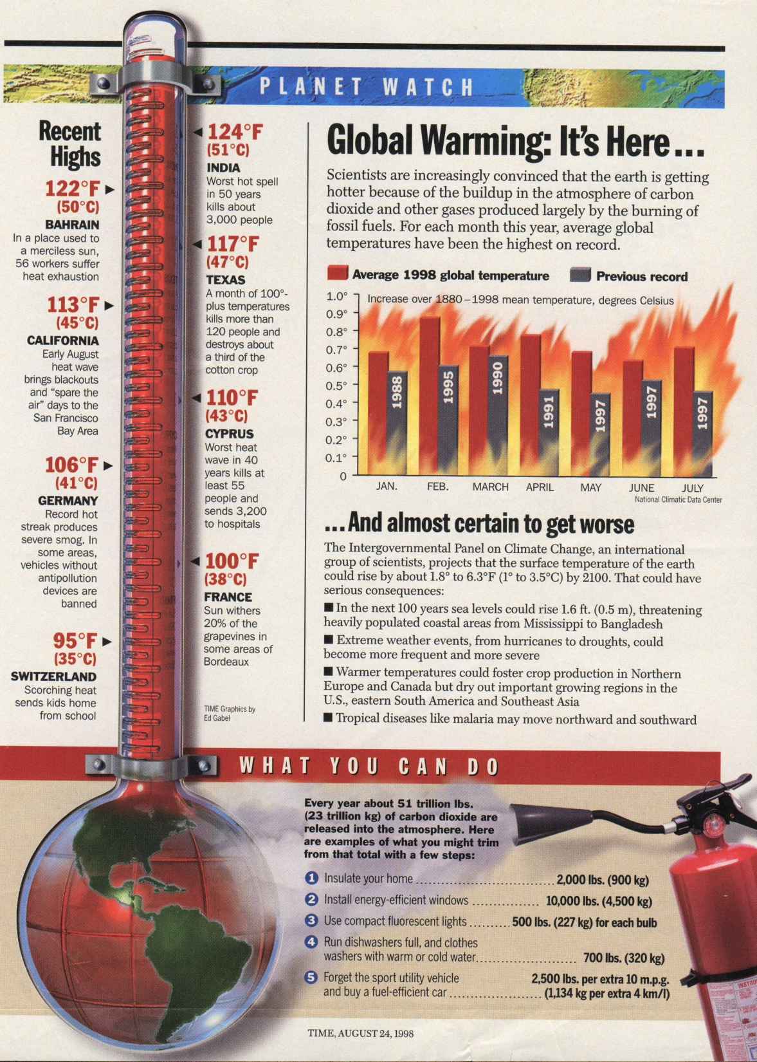
Global Warming
Notes:
Carbon dioxide is responsible for trapping heat on planet earth. Trees and plants naturally absorb excess carbon dioxide from the atmosphere.
In the last 100 years we have removed many forest and the level of global carbon dioxide is increasing.
The net effect is global warming…El Nino and La Nina, floods, drought and extreme weather patterns.

Slide 44
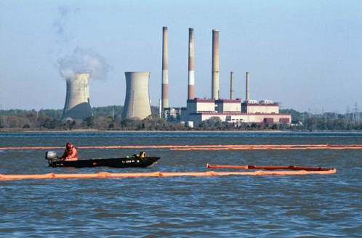
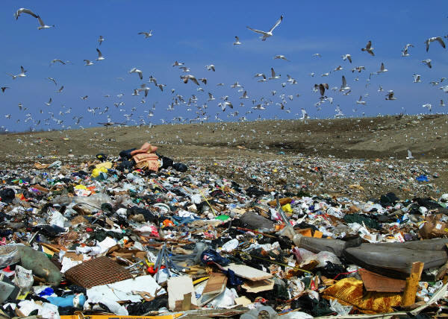
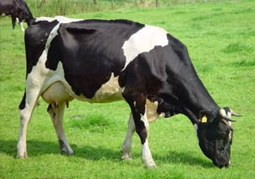
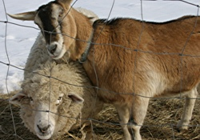

Causes of global warming
Increased levels of CO₂ in the air due to
(a) the burning of fossil fuels and industrialisation
(b) deforestation- cutting down rain forests
Rising levels of CH₄ due
(a) emissions from landfill sites/waste dump
(b) increased number of ruminants
(c) emissions from swamps, bogs, & paddy fields

Slide 45
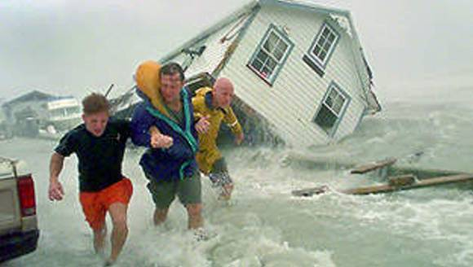
Effects of global warming
Melting snow caps
Rising sea-levels
Flooding lowlands
Desertification
Climate change
Changes in the ecosystems

Slide 46


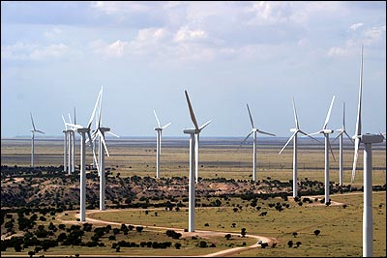
Methods of control
Reduce, Re-use, Recycle – so less landfill sites
Use renewable forms of energy such as wind, water and solar power – so less fossil fuels burnt
Reforestation – plant more trees which act as sinks for CO2
Replacements for CFC’s
Dissolving CO2 in oceans
Residence time is ‘rate of turnover of CO2 in the atmosphere’. Residence time for CO2 is ~ 100years.

Slide 47


Time is running out!

Slide 48


Slide 49

1B.4 Atmospheric Pollution
Air pollution is a situation that exist when there are constituents in the air present to an extent that there is a significant hazard to the present or future health of population or the environment.

Slide 50

Acid Rain
Normal rainwater is slightly acidic, with a pH of 5.6 because CO₂ dissolves in the rain forming H₂CO₃. However acid rain has a pH of between 2 and 5. NO_{X} and SO_{X} are the main contributors to acid rain.
NOx = NO and NO2
SOx = SO2 and SO3

Slide 51


Slide 52



Oxides of nitrogen
The main natural sources of oxides of nitrogen are soil bacteria and lightning discharges, but they are also produced by burning fossils fuels at high temperatures in power stations, cars and supersonic aircraft.

Slide 53

Oxides of nitrogen
Fumes from car exhausts produce nitrogen monoxide and nitrogen dioxide.
These gases react with rainwater to produce nitrous and nitric acid.
NO
NO2 + 2H2O HNO2 + HNO3
nitrous nitric
acid acid

Slide 54

Oxides of sulphur
Some SO₂ comes naturally from volcanoes and rotting vegetation, but most of it comes from burning fossil fuels.
Burning fossils produces SO2 and SO3 which combine with rain to form sulphurous and sulphuric acid.
SO2 + H2O H2SO3 sulphurous acid
SO3 + H2O H2SO4 sulphuric acid.

Slide 55

Specified Demonstration
Effect of SO2 on universal indicator

Slide 56
The effect of sulphur dioxide on universal indicator solution
Method:
Place 25cm³ of universal indicator into a 100cm³ beaker and dilute with equal volume of water.
Place a spatula full of sodium sulphite in a test tube and set up apparatus as shown.
Add dilute HCl drop-wise.
Result:
As SO₂ gas is bubbled into a sample of universal indicator, the pH is gradually lowered as the amount of SO₂ increases and a series of colour changes is seen as the pH drops. Colour changes from green to red.

Slide 57
Sources of Pollution
 | Oxides of Nitrogen NOx = NO NO₂ | Oxides of Sulphur SOx = SO₂ SO₃
Natural | Lightning flashes, nitrogen fixing bacteria | Volcanoes, rotting vegetation
Domestic | Burning of fossil fuels | Burning of fossil fuels
Industrial | Power stations | Power stations
Internal combustion engine | Internal combustion engine | Internal combustion engine

Slide 58





Harmful Effects of Acid Rain
It kills fish
It defoliates trees
It causes erosion of rocks and limestone buildings
It accelerates corrosion of metals

Slide 59
Methods to control Acid Rain
Burn less fossil fuels – use solar and wind power
Use low sulfur fuels instead of fossil fuels
Reforestation – plant more trees
Limestone scrubbers in chimneys to absorb gases
CaCO3 + SO2 CaSO3 + CO2
CaCO₃ → CaO + CO₂
CaO + SO₂ → CaSO₃

Slide 60

1B.5 The Ozone Layer

Slide 61


Ozone O3
It is a pale blue gas, which condenses to a deep blue liquid.
It is found in the upper atmosphere (stratosphere) where it absorbs the harmful UV radiation from the Sun, which can cause skin cancer.
It’s also possible to get a sharp smell of ozone near photocopiers, where electricity passes through the air.
In the lower atmosphere it can be detrimental to health aggravating asthma and bronchitis.

Slide 62

Formation of Ozone
Ozone, O₃
O3 is formed naturally in the stratosphere by the reaction between an oxygen atom and an oxygen molecule.
The oxygen atoms are formed when UV light breaks an oxygen molecule.
  O2 O + O
  This is an example of photodissociation

Slide 63
Formation of Ozone
Ozone, O₃
Oxygen atoms are very reactive as each has an unpaired electron and are called free radicals. As soon as they are formed, they react with oxygen molecules to form ozone.
O + O2 O3
When O₃ absorbs UV light photodissociation of the ozone occurs. O3 O + O2

Slide 64
Formation of Ozone
Ozone, O₃
Some of the oxygen atoms destroy ozone molecules forming oxygen molecules, which are then broken down by UV light to form more oxygen atoms, which lead to the production of more ozone.
O + O3 2O2
So ozone is being made and destroyed all the time!

Slide 65
It was thought that there was a constant amount of ozone in the atmosphere, but in 1984, scientists discovered that the concentration over the Antarctic was decreased. This is often referred to as the ‘hole’. There is also a ‘hole’ in the ozone layer above the Arctic. It occurs there because of the unique climate there.

Slide 66



Chlorofluorocarbons
Thomas Midgley developed Freons and Tetra Ethyl Lead.
CFC’s (chlorofluorocarbons) are a family of compounds that contain the elements chlorine, fluorine and carbon only.
Trichlorofluoromethane
(Freon-11)

Slide 67

Properties CFC’s
Very unreactive and stable in the lower atmosphere.
Long residence time/lifetime ~100 years
Low toxicity
Low boiling points
Low flammability
Uses of CFC’s
As refrigerants/coolants in fridges and freezers.
In air conditioners
In aerosol propellants

Slide 68
However when they are transported into the upper atmosphere/ stratosphere they become very reactive as they are broken down by UV radiation.
The chlorine atoms released then attack ozone.
One single chlorine atom can destroy tens of thousands of ozone molecules.

Slide 69

‘Ozone Hole’
Ozone hole increased 50% from 1975 - 1985

Slide 70
How CFC’s give rise to ozone depletion
They are broken down by UV light in the upper atmosphere to form chlorine radicals.
CCl₃F CCl₂F + Cl
These Cl attack ozone: O₃ + Cl ClO + O₂
A chain reaction is set up.
ClO + O Cl + O₂

Slide 71
Role of NO in destroying ozone
Nitrogen monoxide: NO can also destroy ozone.
NO + O₃ O₂ + NO₂
But chlorine radicals Cl are the main offenders.

Slide 72
Role of Methane in absorbing Cl
Although methane is a greenhouse gas it helps slow down the rate of ozone depletion by removing Cl
CH₄ + Cl CH₃ + HCl

Slide 73

CFC substitutes
HCFC’s (hydrochlorofluorocarbons) are broken down by radicals naturally in the lower atmosphere and don’t reach the upper atmosphere e.g. CHClF₂ (chlorodifluoromethane) which is a propellant used in ‘ozone friendly’ aerosols.
BUT
They do destroy some ozone.
They are greenhouse gases and thus contribute to global warming.
A lot of research is going into HFC’s (hydrofluorocarbons)

